Slide 1
Introduction to Prompt Engineering
Overview of Prompt Engineering
Importance of Crafting Effective Prompts
Examples of Effective Prompts
Notes:
(1:30 - 1:45) 15 minutes
**One Sentence Summary**
- "Introduce the concept of prompt engineering and explain its importance in crafting effective prompts for AI tools."
**Detailed Notes**:
- **Overview of Prompt Engineering**:
- **Definition**:
- Prompt engineering is the process of designing and refining the input prompts given to AI tools, such as ChatGPT and GitHub Copilot, to elicit useful and relevant responses.
- **Role in AI Tools**:
- Effective prompt engineering helps leverage AI capabilities for various tasks, including code generation, debugging, and creating documentation.
- **Example**:
- "When using ChatGPT to generate code, a well-crafted prompt might be: 'Write a Python function to merge two sorted lists into a single sorted list.' This provides clear instructions and context for the AI to generate accurate and relevant code."
- **Importance of Crafting Effective Prompts**:
- **Accuracy and Relevance**:
- The quality of the prompt directly impacts the relevance and accuracy of the AI's response. Ambiguous or vague prompts can lead to incorrect or incomplete outputs.
- **Efficiency**:
- Well-crafted prompts save time by reducing the need for multiple iterations to refine the AI's output.
- **Example**:
- "For debugging, a prompt like: 'Find the error in this Python code snippet for calculating factorials' is more effective than 'Fix this code,' as it provides specific context and expectations."
- **Examples of Effective Prompts**:
- **Code Generation**:
- "Generate a function in C# that sorts an array using quicksort."
- This prompt specifies the programming language and the algorithm, making it clear what is required.
- **Debugging**:
- "Identify the logical error in this Java code for computing the Fibonacci sequence."
- This prompt helps the AI focus on logical errors rather than syntax or other types of issues.
- **Documentation**:
- "Create documentation for a REST API endpoint that retrieves user information by ID."
- This prompt indicates the type of documentation needed and the specific functionality to be documented.
**Background Information**:
- **History of Prompt Engineering**:
- Prompt engineering has gained prominence with the rise of AI language models like GPT-3 and GPT-4. Initially, AI tools required extensive training data and fine-tuning to perform specific tasks. With advancements in AI, particularly in natural language processing, prompt engineering has become a practical approach to harness AI capabilities without extensive customization.
- The concept aligns with the broader trend of making AI more accessible and user-friendly, allowing non-experts to benefit from advanced AI functionalities by simply crafting effective prompts.
**Example**:
- **Real-world Scenario**:
- "In a software development project, a developer might use GitHub Copilot to write boilerplate code for setting up a REST API. By crafting a prompt like 'Generate the initial setup for a REST API in Express.js,' the developer can quickly get a functional codebase and focus on implementing specific features."

Slide 2
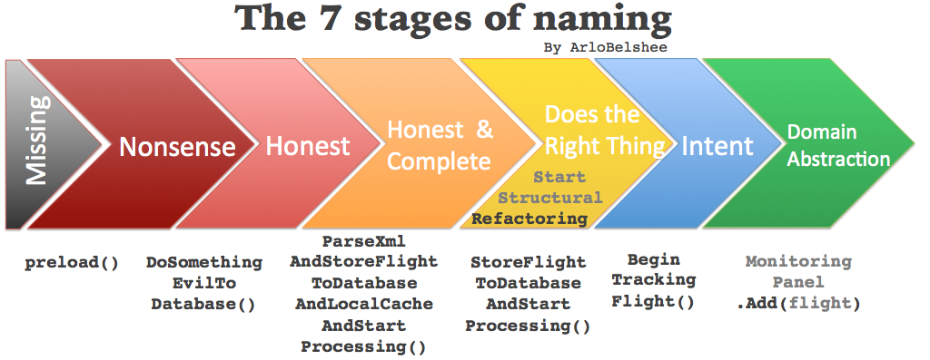
Notes:
(1:45 - 1:50) 5 minutes
**One Sentence Summary**
- "Discuss the seven stages of naming in coding to emphasize the importance of clarity and consistency in naming variables, functions, and classes."
**Detailed Notes**:
- **Overview of the 7 Stages of Naming**:
- **Stage 1: Tentative Name**:
- Start with a provisional name that describes the basic function or data of the variable, function, or class.
- **Example**:
- "For a function that adds two numbers, a tentative name could be `AddTwoNumbers`."
- **Stage 2: Refine Name Based on Context**:
- Refine the name to be more specific based on the context in which it is used.
- **Example**:
- "If the function adds two integers, refining the name to `AddTwoIntegers` provides more clarity."
- **Stage 3: Ensure Consistency with Naming Conventions**:
- Ensure the name follows the project's naming conventions (e.g., camelCase, PascalCase).
- **Example**:
- "In a C# project, use PascalCase for method names, so the function should be named `AddTwoIntegers`."
- **Stage 4: Check for Ambiguity**:
- Ensure the name is unambiguous and clearly indicates its purpose.
- **Example**:
- "Avoid names like `ProcessData` which are too generic and unclear about the function's purpose."
- **Stage 5: Validate Against Existing Names**:
- Ensure the name does not conflict with existing names in the codebase.
- **Example**:
- "Check if there is already a function named `AddTwoIntegers` to avoid naming conflicts."
- **Stage 6: Iterate Based on Feedback**:
- Iterate on the name based on peer feedback and code reviews.
- **Example**:
- "If feedback suggests the name could be clearer, consider renaming to `SumTwoIntegers`."
- **Stage 7: Finalize Name**:
- Finalize the name once it is clear, unambiguous, and consistent with naming conventions.
- **Example**:
- "Finalize the name `SumTwoIntegers` if it clearly describes the function and follows conventions."
**Background Information**:
- **Importance of Naming in Software Development**:
- Naming is a critical aspect of software development that significantly impacts code readability and maintainability. Clear and consistent naming conventions help developers understand the purpose and functionality of code elements, making it easier to collaborate and maintain the codebase over time.
- The practice of thoughtful naming dates back to early programming languages, where mnemonic naming was used to make code more understandable. Over time, as software development has evolved, the importance of naming has been emphasized in various programming methodologies and best practices.
**Example**:
- **Real-world Scenario**:
- "In a large codebase, using clear and consistent names helps new developers quickly understand the code. For example, in a banking application, a function named `CalculateInterestForSavingsAccount` immediately conveys its purpose, whereas a name like `CalcInt` would be ambiguous and confusing."

Slide 3
Common Refactorings (1:50 - 2:00)
Overview of Refactoring: Define refactoring and its role in software development.
Importance of Refactoring: Explain why regular refactoring is crucial for long-term code quality.
Examples of Common Refactorings: Provide examples such as Extract Method, Rename Variable, and Inline Variable.

Slide 4
The Three Laws of TDD (2:00 - 2:05)
1st Law: Write a Failing Unit Test: You may not write production code until you have written a failing unit test.
2nd Law: Write Only Enough of a Unit Test to Fail: You may not write more of a unit test than is sufficient to fail, and not compiling is failing.
3rd Law: Write Only Enough Production Code to Pass the Test: You may not write more production code than is sufficient to pass the currently failing test.

Slide 5
Introduction to Stubs, Mocks, Fakes, and Doubles (2:05 - 2:15)
Overview: Define stubs, mocks, fakes, and test doubles.
Stubs: Provide predefined responses to method calls.
Mocks: Verify interactions with dependencies.
Fakes: Implement simpler versions of complex dependencies.
Test Doubles: General term for stubs, mocks, and fakes.

Slide 6
Task API Application Overview (2:15 - 2:30)
Overview of the Application: Describe the purpose and structure of the task application.
Components: List and briefly describe key components like models, controllers, and views.
In-Memory Database: Explain the use of SQLite for simplicity and quick setup.
Demo of Migrations: Show how migrations work in setting up the database schema.

Slide 7
Setting Up the Project (2:30 - 2:40)
Setup: Ensure everyone has the project files and dependencies installed.
Review Existing Tests: Walk through the existing tests and explain how to run them.
Address Setup Issues: Help participants resolve any setup issues.

Slide 8
Add a Feature to the Task Application (2:40 - 3:25)
Add 'Priority' Field: Describe the new field and its enum values.
Return Text for Priority: Ensure the API returns text values for priority instead of numbers.
Order Tasks by Priority and Due Date: Explain how to order tasks first by priority and then by due date.
Hands-On Exercise: Guide participants through the implementation process.

Slide 9
Setup Continuous Integration using GitHub Actions (3:25 - 3:40)
Overview of CI: Explain the concept of continuous integration and its benefits.
GitHub Actions: Introduce GitHub Actions as a CI tool.
Setting Up CI: Walk through the steps to set up GitHub Actions for the project.
Example Workflow: Provide an example of a simple workflow configuration.
Hands-On Exercise: Guide participants through setting up their workflow.

Slide 10
Emergent Design (3:40 - 3:45)
Definition: Explain emergent design and how it evolves through the development process.
Benefits: Discuss the benefits of allowing design to emerge naturally.
Practical Application: Provide examples of how to apply emergent design in real projects.

Slide 11
Simple Design (3:45 - 3:50)
Definition: Define simple design and its core principles.
Benefits: Explain the benefits of maintaining a simple design.
Practical Application: Provide examples of how to apply simple design principles in real projects.

Slide 12
The 10 Minute Rule (3:50 - 3:55)
Definition: Define the 10 Minute Rule and its purpose.
Benefits: Discuss the benefits of applying the 10 Minute Rule.
Practical Application: Provide examples of how to implement the 10 Minute Rule in daily work.

Slide 13
Legacy Code and TDD (3:55 - 4:10)
Definition of Legacy Code: Define legacy code and the challenges it presents.
Role of TDD: Explain how TDD can help improve and maintain legacy code.
Practical Application: Provide examples of applying TDD to legacy code.

Slide 14
Introduction to GitHub Actions and Deployment (4:10 - 4:20)
Overview of GitHub Actions: Explain what GitHub Actions is and its capabilities.
Benefits of CI/CD: Discuss the benefits of continuous integration and continuous deployment.
Introduction to Free Cloud Providers: Introduce free cloud providers like Heroku, Vercel, and Netlify.
Example Workflow: Provide an example of a GitHub Actions workflow for deployment.

Slide 15
Hands-On Exercise: Deploying the Task Application (4:20 - 4:30)
Instructor Demonstration: Demonstrate how to set up GitHub Actions for CI and configure deployment to a free cloud provider.
Hands-On Practice: Guide participants through setting up their workflow and deploying their applications.
Provide Guidance and Support: Assist participants with any issues they encounter during the exercise.

Slide 16
Wrap-Up and Q&A (4:30 - 4:45)
Summarize Key Takeaways: Recap the main concepts covered in the afternoon session.
Open Floor for Questions: Invite participants to ask questions and discuss any challenges they faced.
Provide Additional Resources: Suggest further reading and resources for continued learning.

Slide 17
Conclusion of the Course (4:45 - 5:00)
Recap Key Concepts: Summarize the main topics covered throughout the course.
Encourage Application: Encourage participants to apply what they've learned in their future projects.
Provide Additional Resources: Offer additional resources and contact information for further support.
Thank Participants: Thank the participants for their engagement and participation.

